Slide 1
K-Nearest Neighbour classifier
Bhuvaneshwari Patil

Slide 2
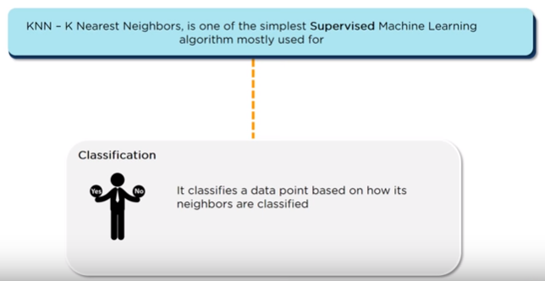
What is KNN?
Called as Instance-based learning
lazy algorithm

Slide 3
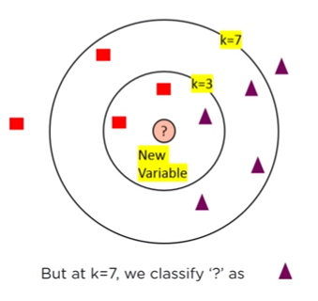
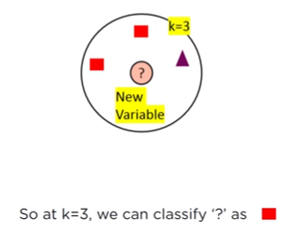
Parameter tuning
The choice of k is not trivial
Make it too small, sensitive to noise
too large and the accuracy reduces as points that are too far away are considered

Slide 4
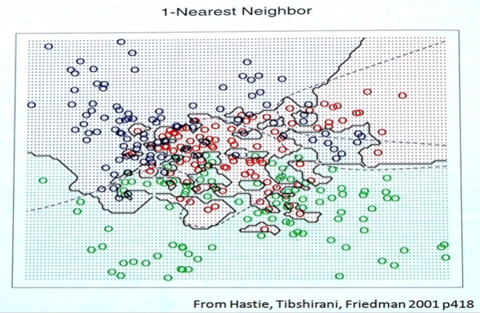

Slide 5
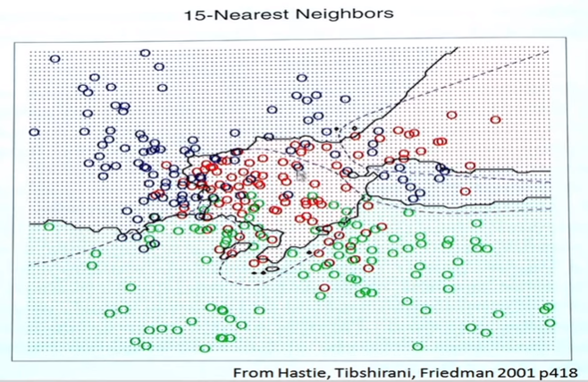

Slide 6
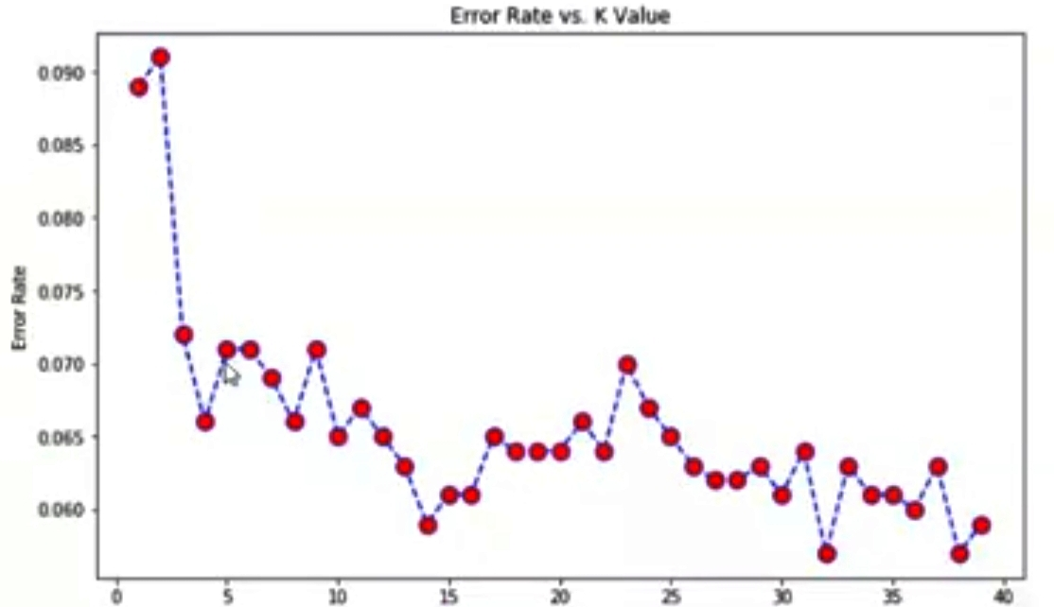
Error rate vs. k value

Slide 7
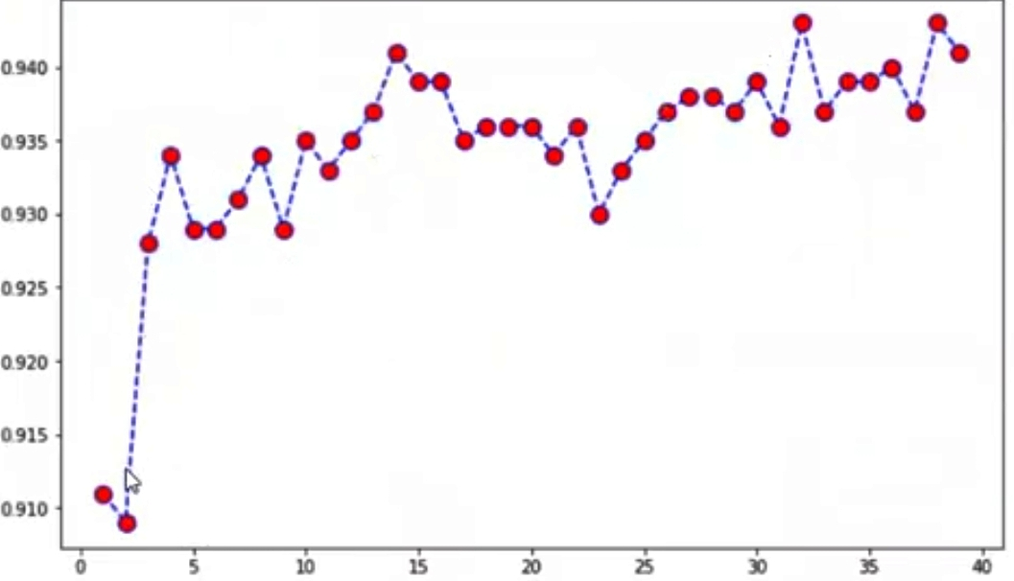
Accuracy vs K-value

Slide 8
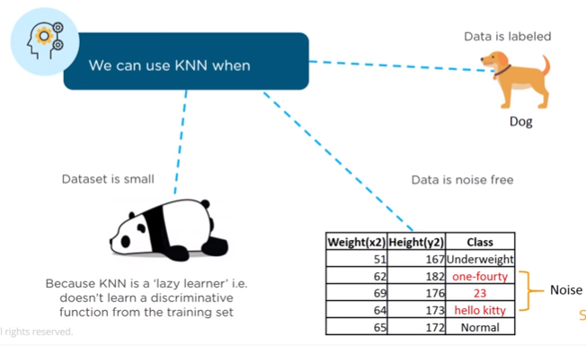
When to use KNN

Slide 9
Basics of KNN
Training method:
Save the training examples
At Prediction time:
Find the ‘K’ training examples (x1,y1), (x2,y2),…,(xk,yk) that are closest to the test example ‘x’
Classification: Predict the most frequent class among yi’s
Regression: Predict the average of among the yi’s

Slide 10
KNN Algorithm steps
1. Load the data
2. Initialize K to your chosen number of neighbors
3. For each example in the data
3.1 Calculate the distance between the query example and the current example from the data.
3.2 Add the distance and the index of the example to an ordered collection
4. Sort the ordered collection of distances and indices from smallest to largest by the distances
5. Pick the first K entries from the sorted collection
6. Get the labels of the selected K entries
7. If regression, return the mean of the K labels
8. If classification, return the mode of the K labels

Slide 11

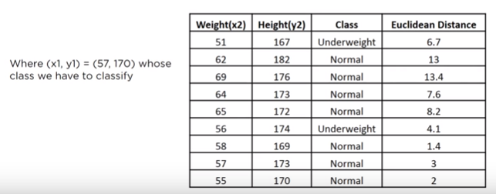
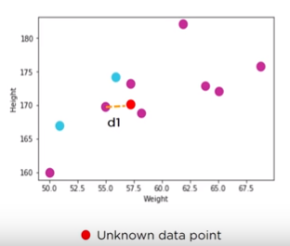
KNN example
Assume k=3
Therefore, data point (57,170) belongs to class Normal

Slide 12
KNN example
Suppose we have height, weight and T-shirt size of some customers and we need to predict the T-shirt size of a new customer with only height and weight information (161cm, 61kg). Data including height, weight and T-shirt size information is shown below –
H – Height in cms
W – Weight in kgs
S – T – Shirt size Assume k=5
H | 158 | 158 | 158 | 160 | 160 | 163 | 163 | 160 | 163 | 165 | 165 | 165 | 168 | 168 | 168 | 170 | 170 | 170
W | 58 | 59 | 63 | 59 | 60 | 60 | 61 | 64 | 64 | 61 | 62 | 65 | 62 | 63 | 66 | 63 | 64 | 68
S | M | M | M | M | M | M | M | L | L | L | L | L | L | L | L | L | L | L

Slide 13
H | W | S | ED
158 | 58 | M | 4.2426
158 | 59 | M | 3.6056
158 | 63 | M | 4.2426
160 | 59 | M | 4.2426
160 | 60 | M | 1.4142
163 | 60 | M | 2.2361
163 | 61 | M | 1.4142
160 | 64 | L | 1.4142
163 | 64 | L | 3.6056
165 | 61 | L | 4
165 | 62 | L | 3.6056
165 | 65 | L | 3.6056
168 | 62 | L | 7.0711
168 | 63 | L | 7.2801
168 | 66 | L | 7.0711
170 | 63 | L | 7.0711
170 | 64 | L | 9.4868
170 | 68 | L | 11.402
The customer with 161cm height and 61kg weight needs medium size t-shirt

Slide 14
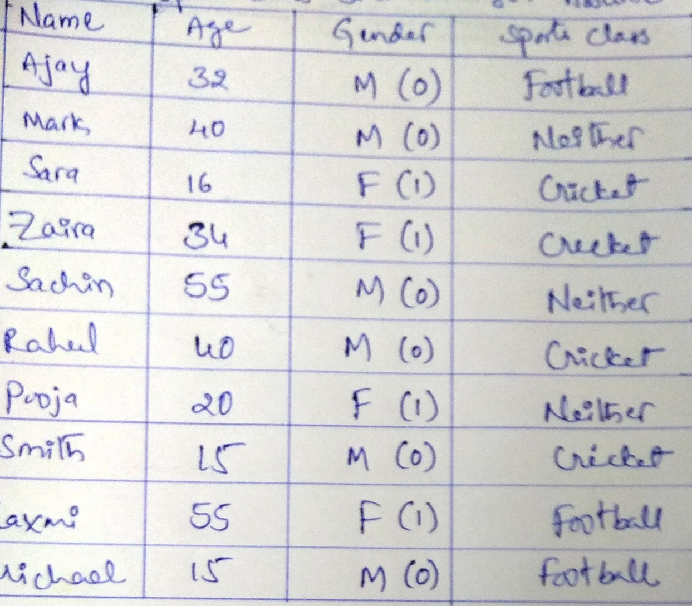
KNN Example: Consider the following data and find out to which sports class (Sudha, 5, female) belongs to, using KNN classifier . Assume K=3
Convert categorical data into numerical data (gender)

Slide 15
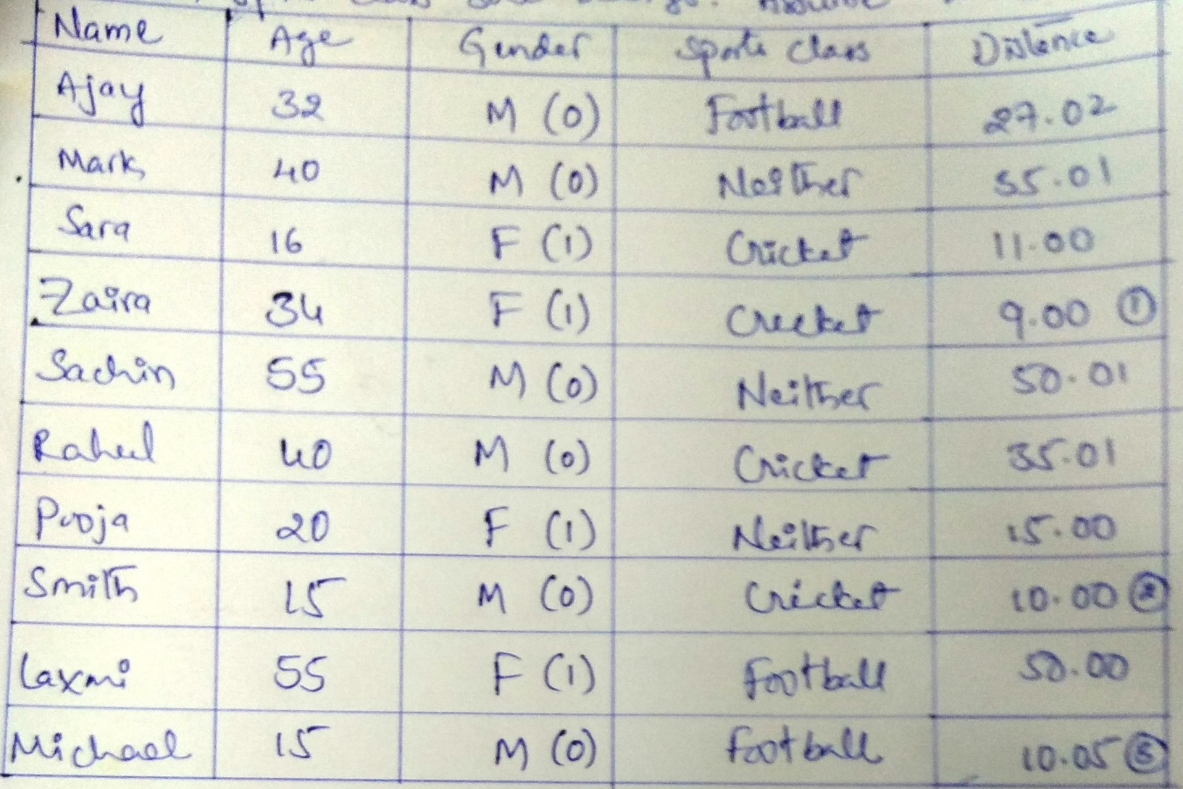
KNN example continued:
So, Sudha belongs to cricket class

Slide 16
Advantages and Disadvantages
Advantages
The algorithm is simple and easy to implement
There’s no need to build a model, tune several parameters, or make additional assumptions.
The algorithm is. versatile
classification, regression, and search
Works easily on multi-class problems
Disadvantages
Memory Intensive / Computationally expensive
impractical choice in environments where predictions need to be made rapidly
suffers from the curse of dimensionality
Sensitive to scale of data, the computational costs get higher as the number of dimensions grows - adaptive nearest neighbor methods
Struggle when high number of independent variables
Not work well on rare event (skewed) target variable

Slide 17
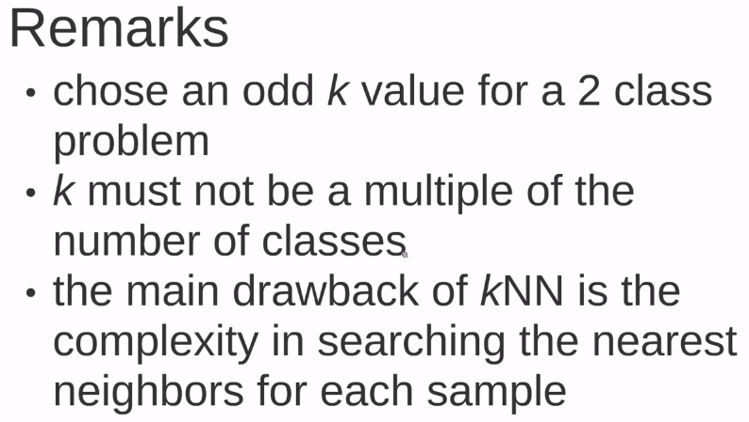

Slide 18
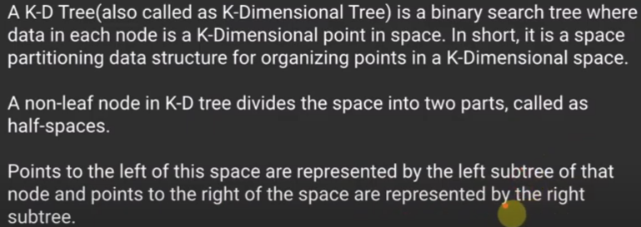
KD Tree

Slide 19
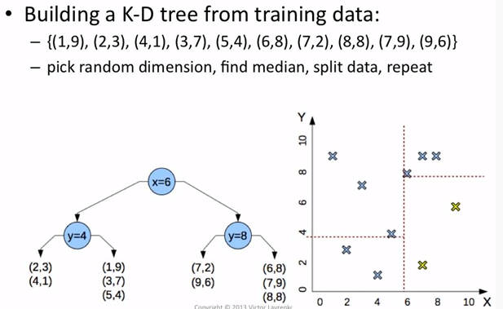
KD tree example - splitting

Slide 20
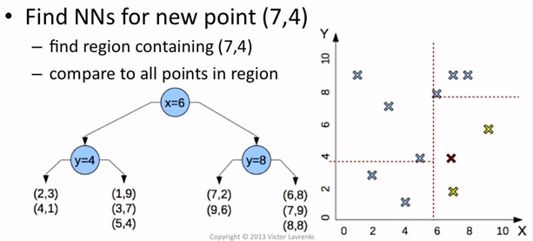
KD tree example – finding neighbours

Slide 21
Why KNN is non-parametric?
Non-parametric means not making any assumptions on the underlying data distribution.
Non-parametric methods do not have fixed numbers of parameters in the model.
Similarly in KNN, model parameters actually grows with the training data set - you can imagine each training case as a "parameter" in the model

